Slide 1
Generative Multi-Adversarial Networks
Chineme Uba
Michael Acquah

Slide 2
Content
Problem Motivation
Problem Setup and Formulation
Experiments
Challenges Faced and Learnings
Future Directions

Slide 3
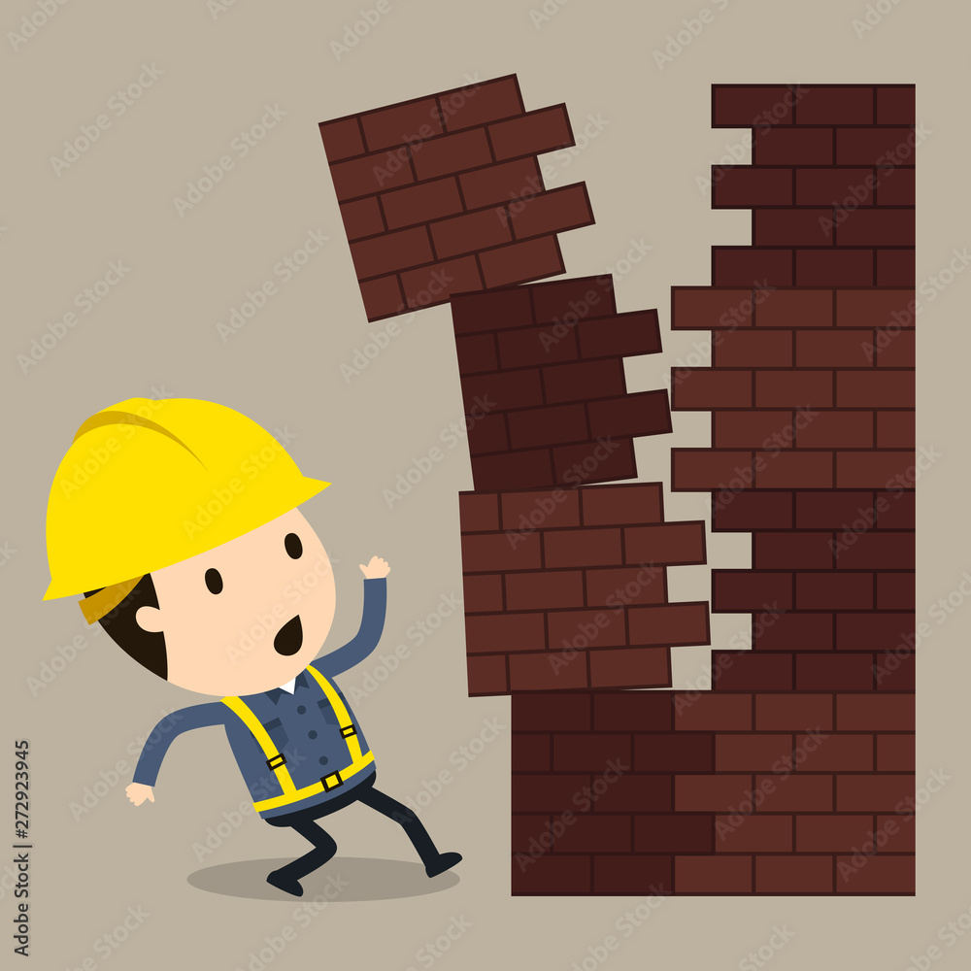
Problem Motivation
Training Generative Adversarial Networks (GANs) remains a challenging task due to issues such as mode collapse and training instability. These problems hinder the generator's ability to learn a diverse and realistic data distribution effectively.
To address this, the original GMAN framework introduces multiple discriminators to provide diverse feedback to the generator, helping improve training stability and sample quality. However, in that setup, all discriminators share the same architecture.
In our approach, we extend this idea by using different discriminators, each with different dropout rates and convolutional configurations to diversify the feedback even further. We propose that this architectural diversity leads to better generalization and more robust learning dynamics while using the original objective function.
Our goal is to enhance training efficiency, achieve faster convergence, and generate higher-quality image samples.

Slide 4
Problem Setup and Formulation
In our work, we address the training instability and mode collapse issues common in GANs by extending the GMAN approach.
Our work keeps the original GAN objective function unchanged, ensuring compatibility with standard training dynamics.
Images are evaluated by 4 discriminators per dataset, each offering a unique architectural perspective.

Slide 5

Problem Setup and Formulation
Discriminator Design:
Discriminator 1: Baseline architecture from the GMAN paper.
Discriminators 2–4: Varied in kernel size, depth, dropout rates, and number of filters to capture different spatial and semantic patterns.
Key Variations:
Dropout: Ranges from 0.2 to 0.3
Kernel Sizes: From 3×3 to 6×6
Channels: Up to 1024 filters in deeper layers for all datasets
Fully Connected Layers: Adjusted to match feature map sizes per dataset resolution
Training Strategy:
The generator is trained using feedback aggregated from all 4 discriminators.
Discriminator loss and generator loss are averaged across all the different images.

Slide 6
Experiments
Objective: Test whether architectural diversity across discriminators improves GAN training without altering the original adversarial loss function.
Loss: Binary Cross-Entropy (unchanged from baseline GMAN setup).
Datasets:
MNIST (grayscale → RGB, 32×32)
CIFAR-10 (RGB, 32×32)
CelebA (RGB, 64×64)
Models:
1 shared generator per dataset
4 discriminators with different architectures
Training:
10 epochs
Batch size: 32
Latent dimension: 100
4 discriminators trained in parallel, generator uses averaged feedback.
Same learning rate, optimizer (Adam), and betas across all components

Slide 7
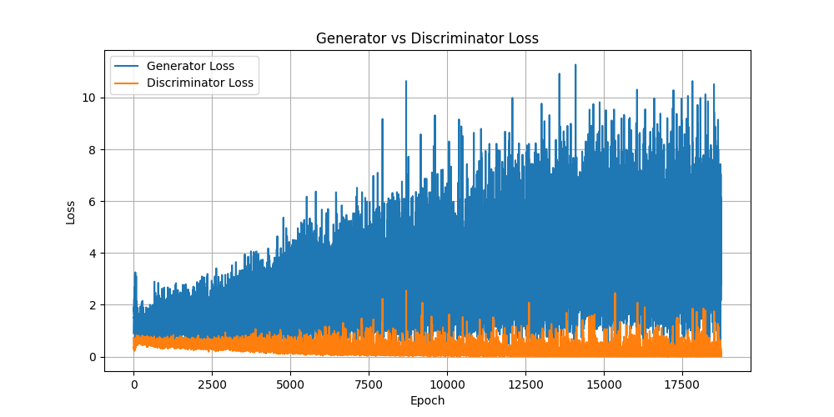
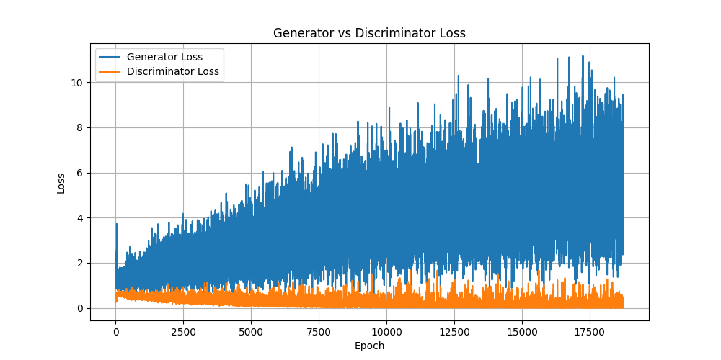
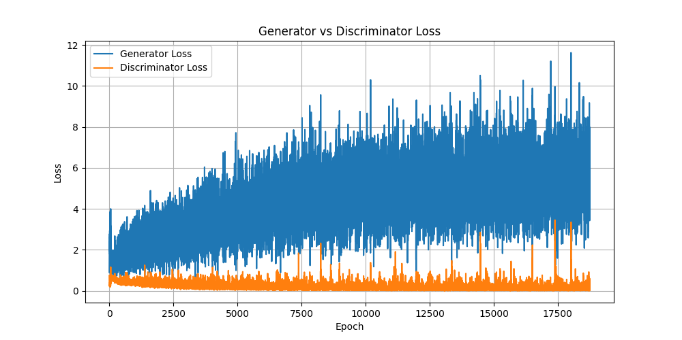
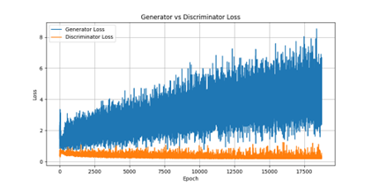
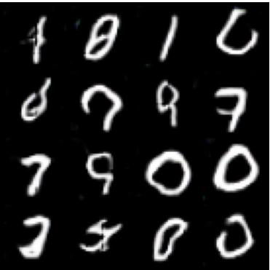
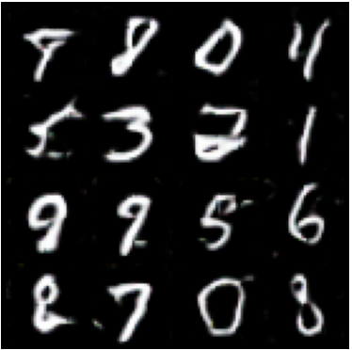
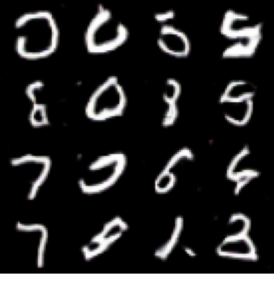
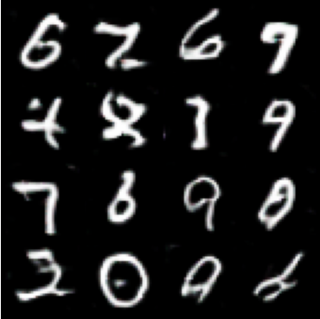
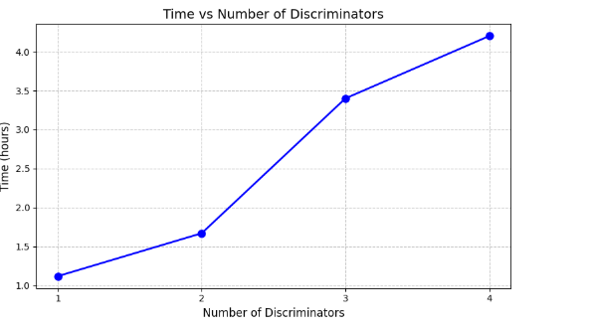
Results - MNIST
 | Discriminator = 1 | Discriminator = 2 | Discriminator = 3 | Discriminator = 4
Loss
Output

Slide 8
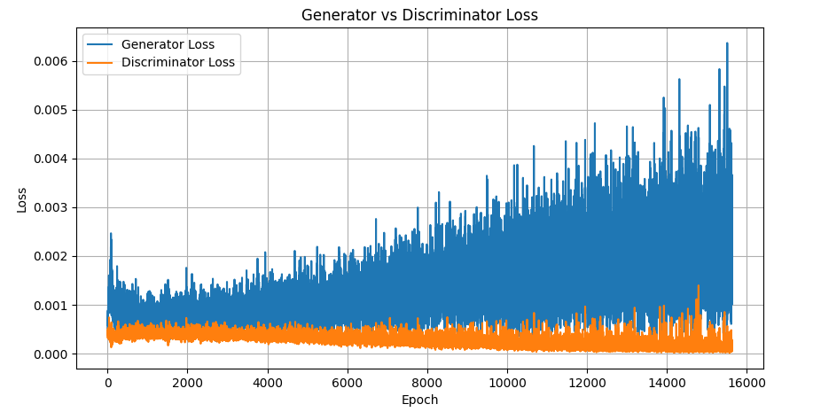
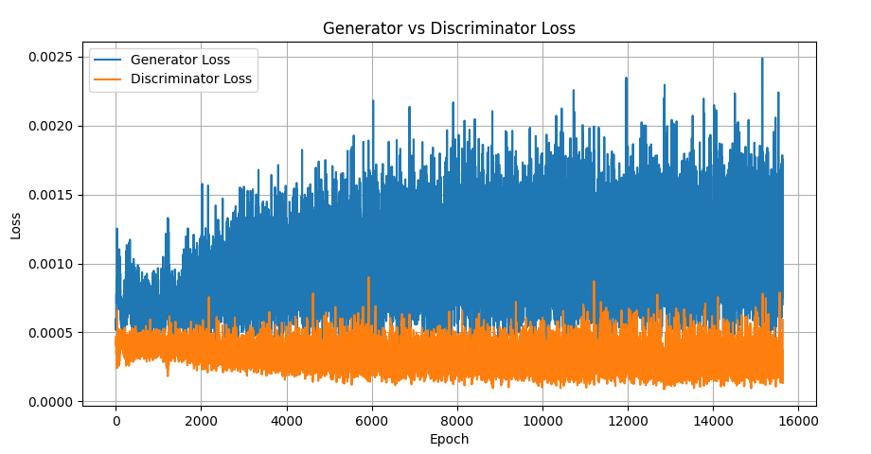
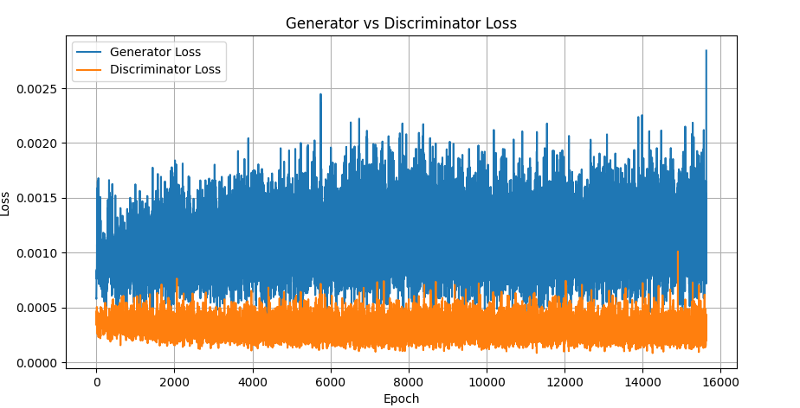
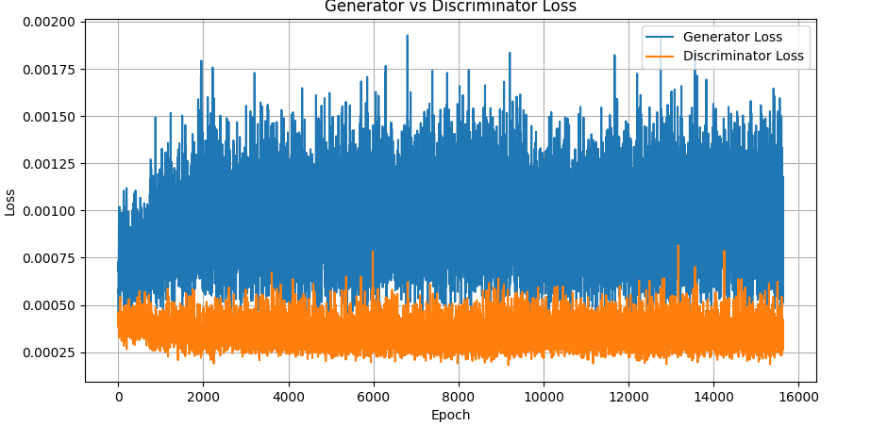
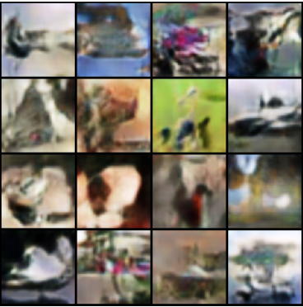
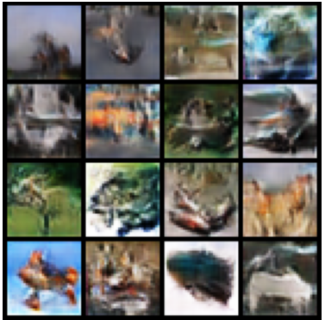
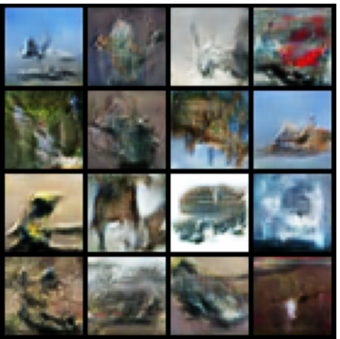
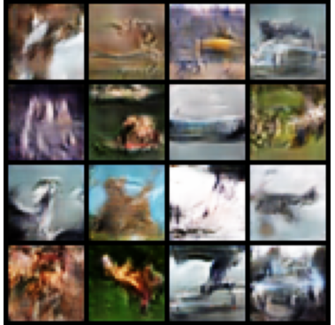
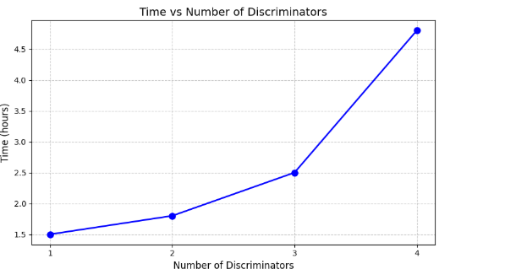
Results - CIFAR
 | Discriminator = 1 | Discriminator = 2 | Discriminator = 3 | Discriminator = 4
Loss
Output

Slide 9
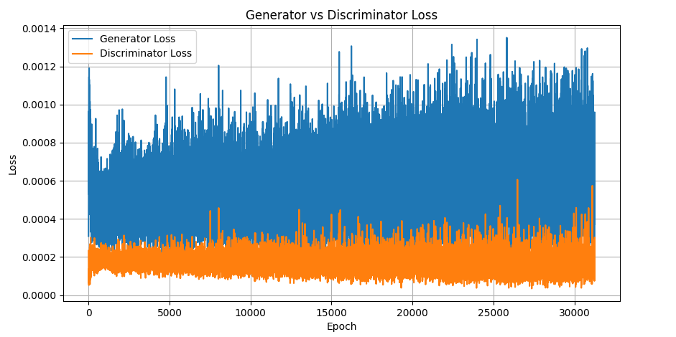
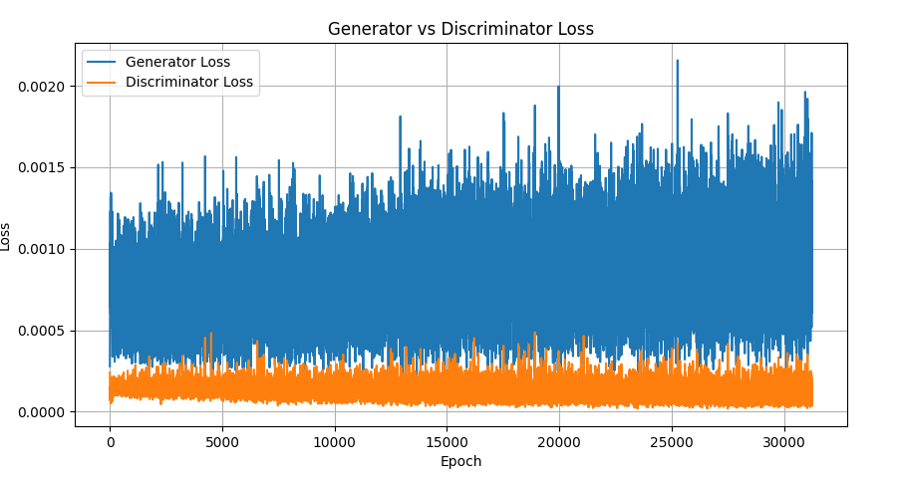
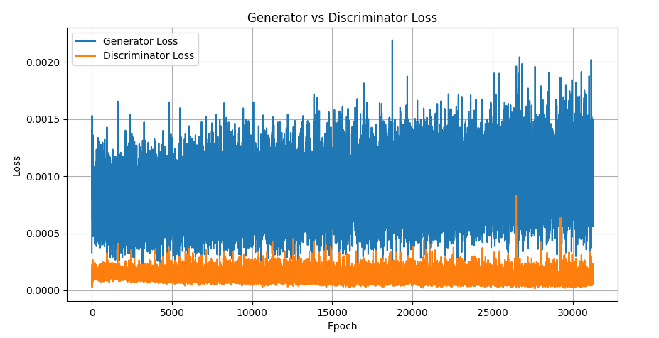
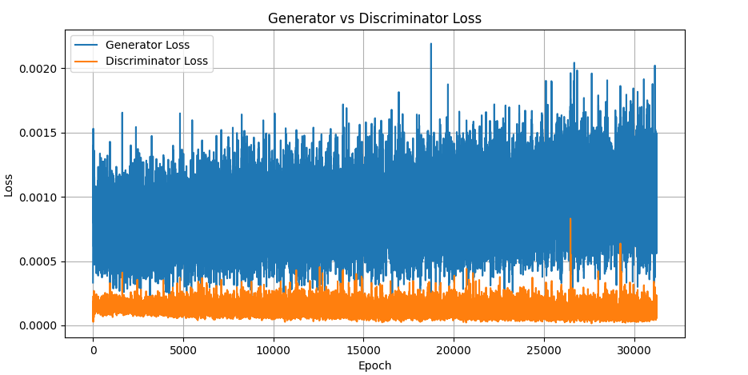
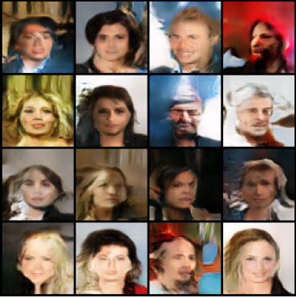
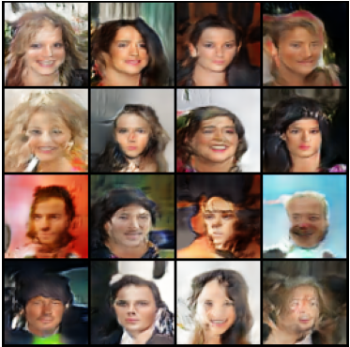
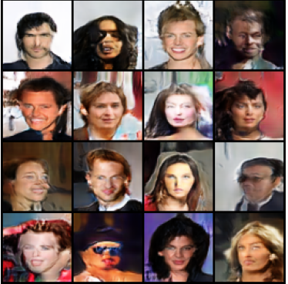
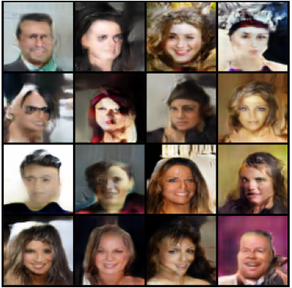
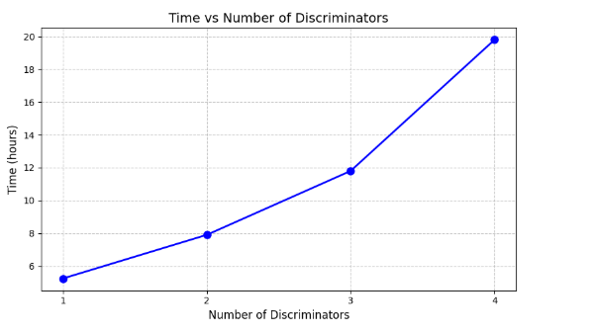
Results - CELEB
 | Discriminator = 1 | Discriminator = 2 | Discriminator = 3 | Discriminator = 4
Loss
Output

Slide 10
Challenges
.
Selecting appropriate convolution layers for each discriminator was not easy. The goal was to extract meaningful image features that the generator could learn effectively. Kernel sizes were varied from 3×3 to 6×6, beyond the typical 3×3 and 5×5, to analyze feature granularity.
Datasets (MNIST, CIFAR-10, CelebA) had different input formats and resolutions. All images were upscaled to 64×64 to preserve features and standardize input size. MNIST (originally grayscale) was converted to 2 by duplicating channels to match the generator/discriminator inputs.
Google Colab (free tier) imposed runtime limits, causing training to halt unexpectedly. To overcome this, training was migrated to on-campus GPU systems, involving coordination across three different machines. This experience highlighted the importance of resource planning and reaching out for technical support when needed.

Slide 11
Future Directions
The current binary cross-entropy loss may not be optimal for all datasets. Future work could involve a comparative study of various GAN objective functions (e.g., WGAN, LSGAN, Hinge loss). Objective functions may be tailored per dataset to balance quality and efficiency.
Inspired by the GMAN paper, we could experiment with using only the strictest (most discriminating) of the four discriminators. This may lead to stronger gradients and sharper image generation, potentially improving sample realism.
Another direction is to reduce image resolution (e.g., to 16×16) to test performance at low-complexity scales, speed up training and reduce compute cost and also investigate how much structural fidelity is retained

Slide 12
References
[1] A. Ghosh, V. Kulharia, V. Namboodiri, P. H. S. Torr, and P. K. Dokania, “Multi-Agent Diverse Generative Adversarial Networks.”
[2] J. Yu and J. Liu, “Multiple Granularities Generative Adversarial Network for Recognition of Wafer Map Defects,” IEEE Trans Industr Inform, vol. 18, no. 3, pp. 1674–1683, Mar. 2022, doi: 10.1109/TII.2021.3092372.
[3] T. Pandeva and M. Schubert, “MMGAN: Generative Adversarial Networks for Multi-Modal Distributions,” Nov. 2019, [Online]. Available: http://arxiv.org/abs/1911.06663
[4] I. Durugkar, I. Gemp, and S. Mahadevan, “Generative Multi-Adversarial Networks,” Nov. 2016, [Online]. Available: http://arxiv.org/abs/1611.01673

Slide 13
THANK YOU!

